Slide 1
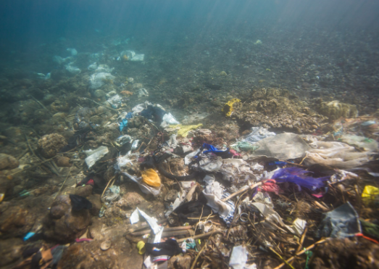
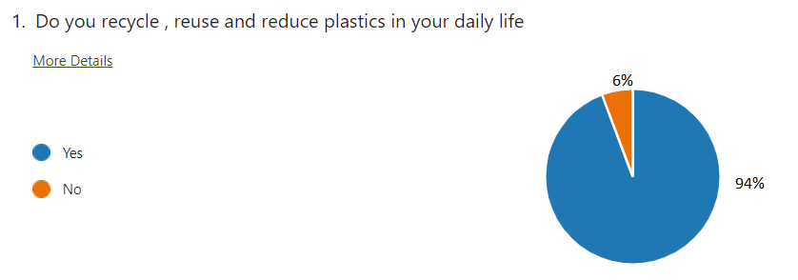
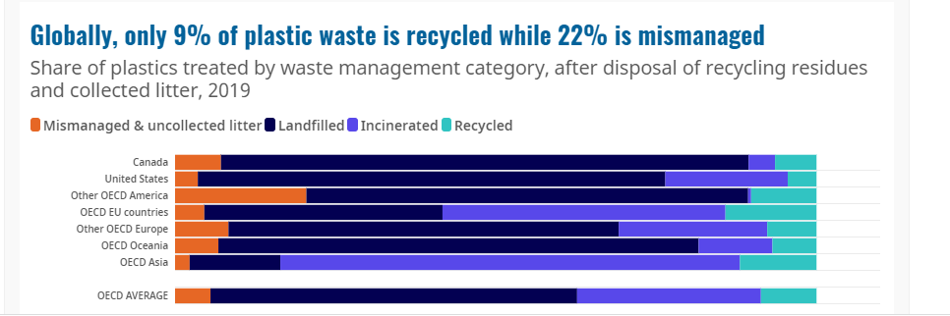
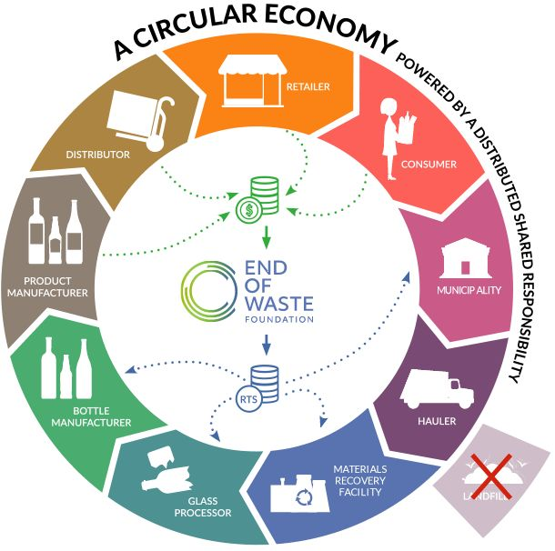

Every year we dumped a massive 2.12 billion tons of waste in Landfilled. How are we going to live with this in Future ?
Survey Result show positive response from Community that everyone aware regarding Reduce, Recycle and Reuse , but how many of us really agree we have such environment or facility being set in community ?
Objective : To reduce the garbage on the landfill by 30% , will eventually we will be having Eco Friendly environment
Vision: To improve the Waste Management system in the community.

